Slide 1
Grade Distribution Prediction with Deep Learning
Deep Dive Project Group 9

Slide 2
Problem Motivation
The grade distribution of a class plays an important role in helping students decide whether to register for the class. It provides valuable insights into the course's difficulty level by considering factors such as the class location, size, subject, and timing. With this information, students can make informed decisions about their academic planning and manage their workload effectively, so that they choose courses that align with their goals and capabilities.
pg2. Dou Hoon Kwark

Slide 3
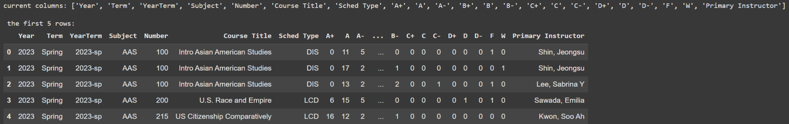
Exploratory Data Analysis (EDA)
Categorical Features (8)
Year
Term
YearTerm
Subject
Number
Course Title
Schedule Type
Primary Instructor
Numerical Features (14)
A+
A
A-
…
D
D-
F
W
pg3. Dou Hoon Kwark

Slide 4
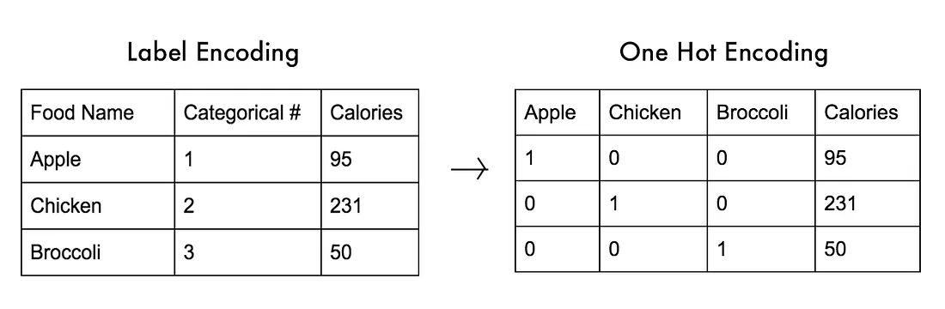
EDA Data Pre-processing
One-hot encoding feature Year
pg4. Dou Hoon Kwark
https://medium.com/@michaeldelsole/what-is-one-hot-encoding-and-how-to-do-it-f0ae272f1179

Slide 5
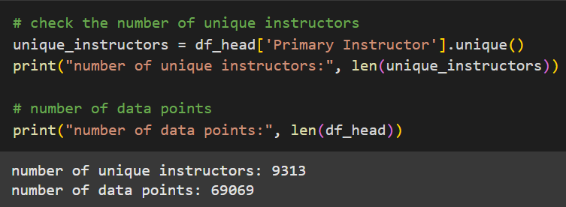
EDA Data Pre-processing
The following aspects in the dataset is likely to unnecessarily lead the model to too high dimension:
The total number of unique instructors/course titles
The scarcity of some instructors/course titles
+ Course title can be inferred from Subject + (Course) Number
pg5. Dou Hoon Kwark

Slide 6
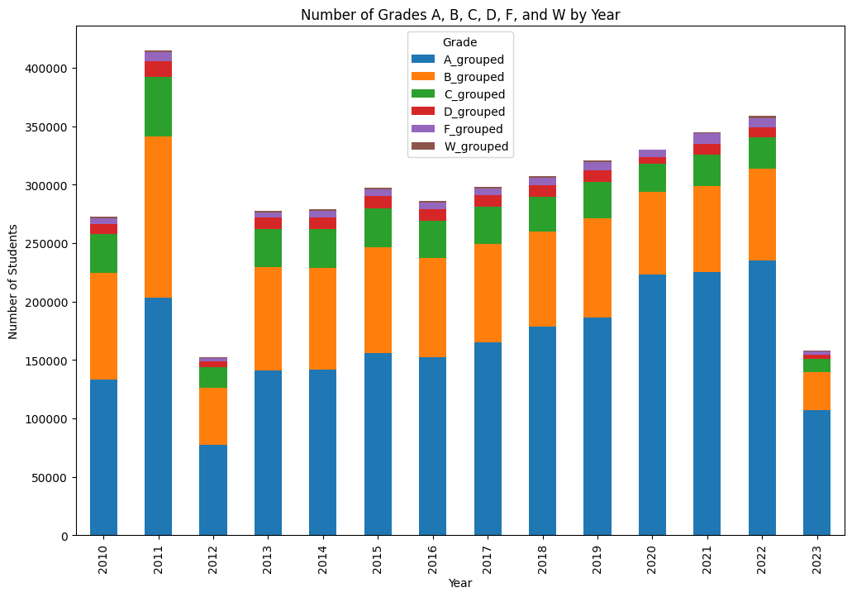
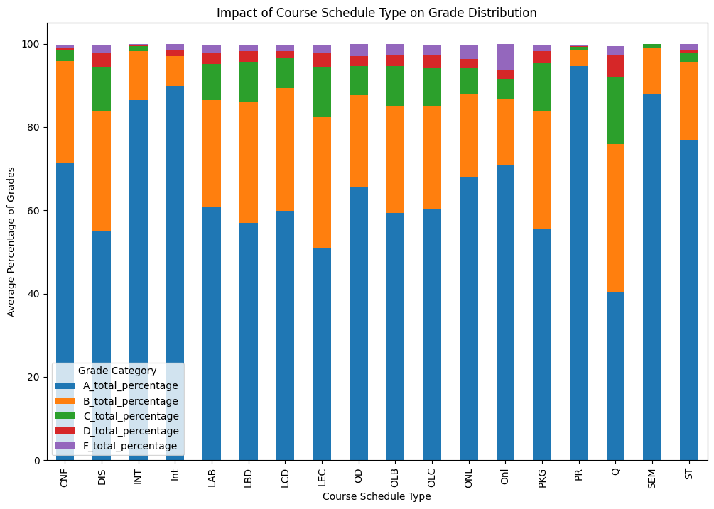
EDA Cont’d
Year ↑ Number of students ↑ Percentage of A ↑
Course Schedule Shows interesting correlations with Grades
pg6. Dou Hoon Kwark

Slide 7
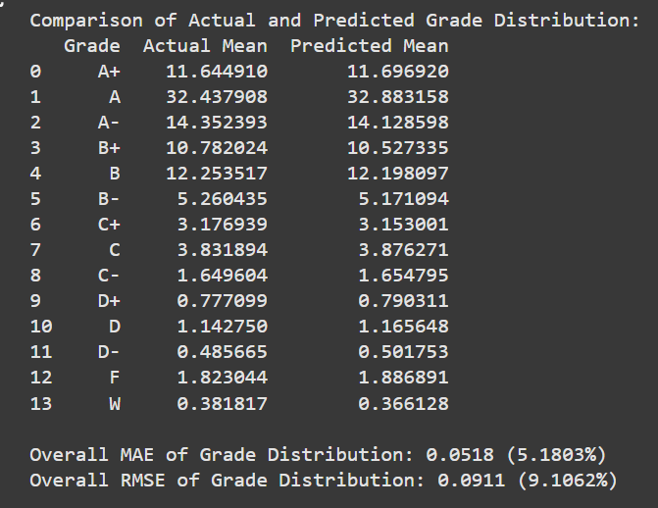
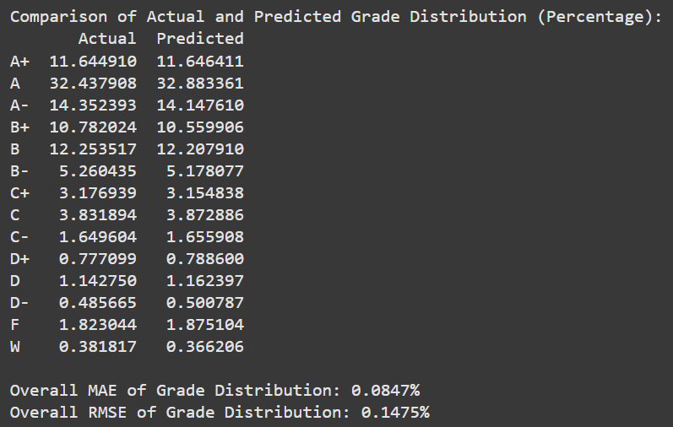
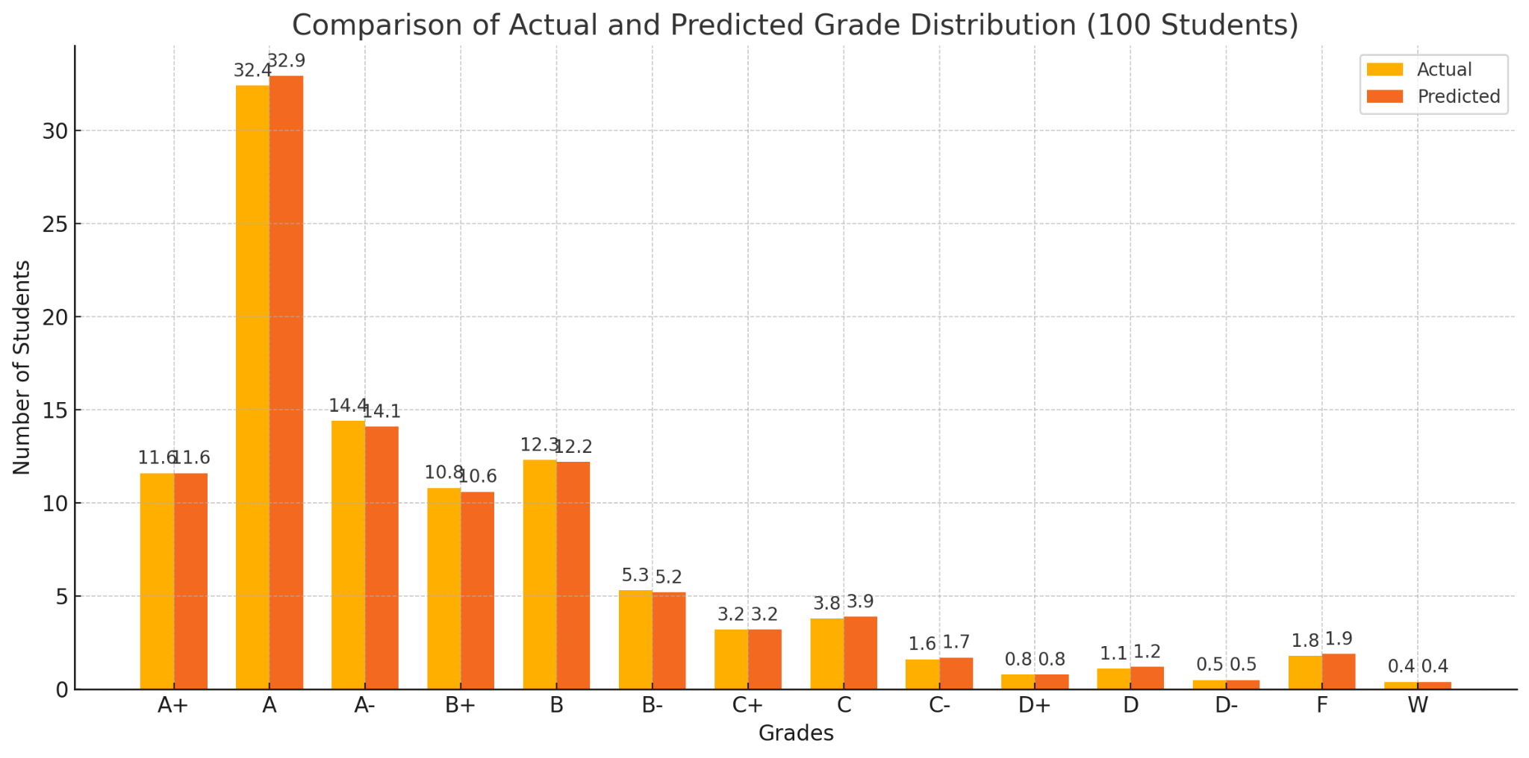
Baseline model – Linear Regression
The actual grade distribution and predicted grade distribution are very similar.
For an example of 100 students in a class, we predicted that 32.8 students would get grade A, and in reality, 32.4 students did.
Taking into consideration all the grade predictions, our average prediction is 5.18% off from the real answer.
pg7. Dou Hoon Kwark

Slide 8
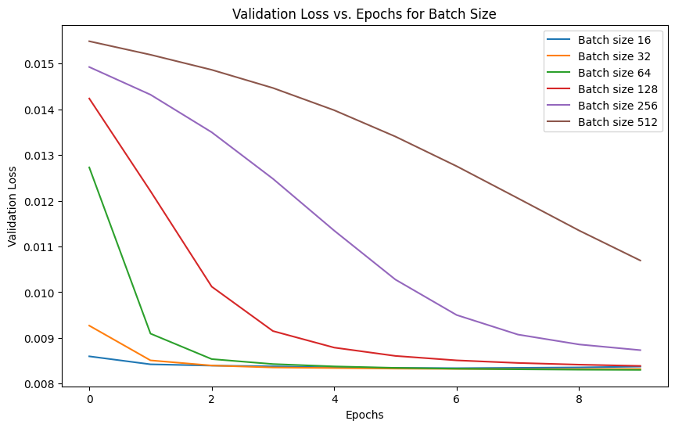
Neural Network Model- Batch Size Optimization
pg8. Yixuan Li

Slide 9
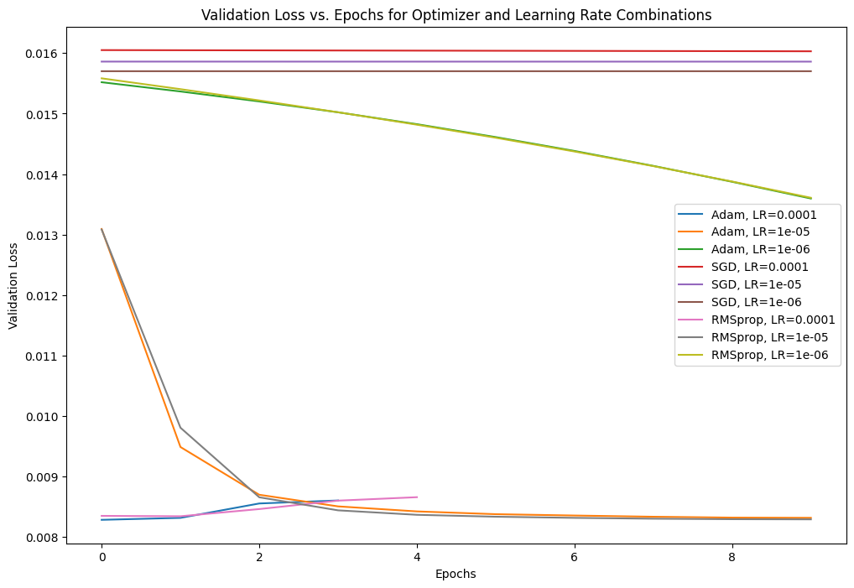
Neural Network Model- Optimizer Selection
pg9. Yixuan Li

Slide 10
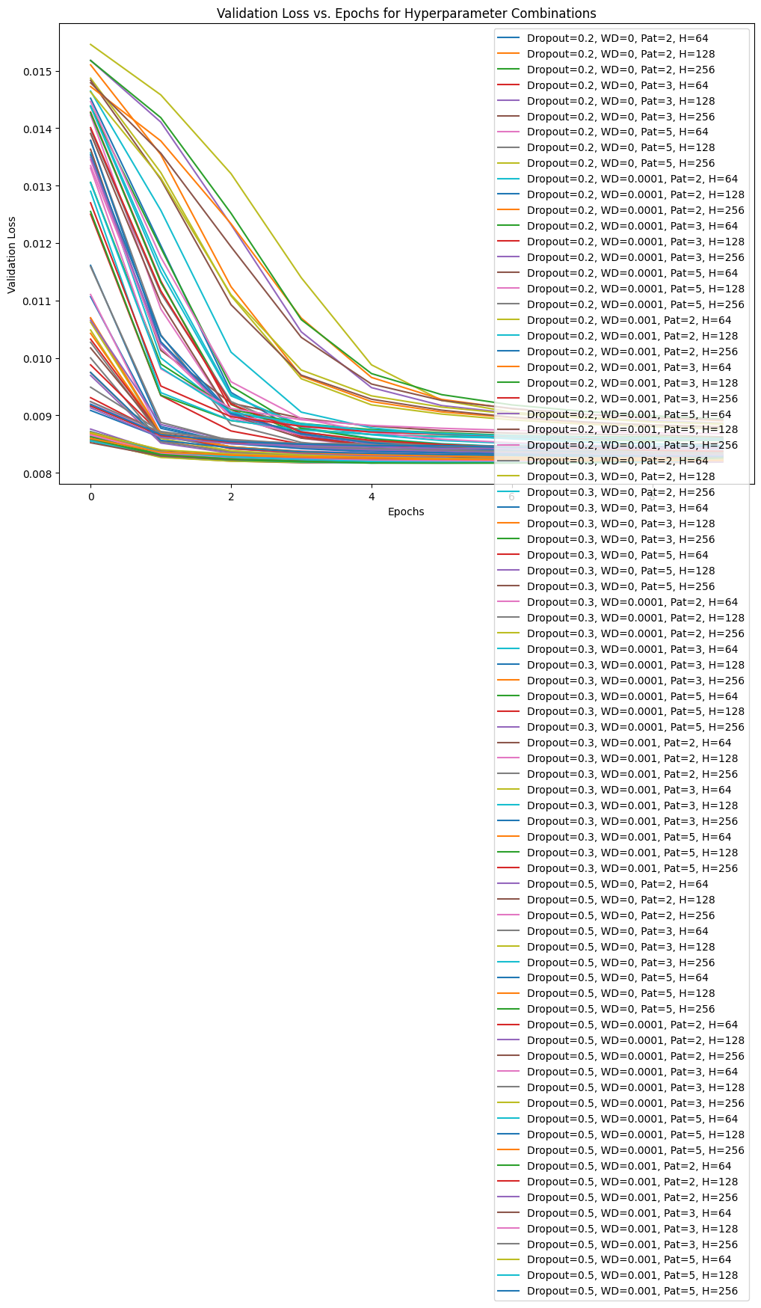
Neural Network Model- Hyperparameter Training
pg10. Yixuan Li

Slide 11
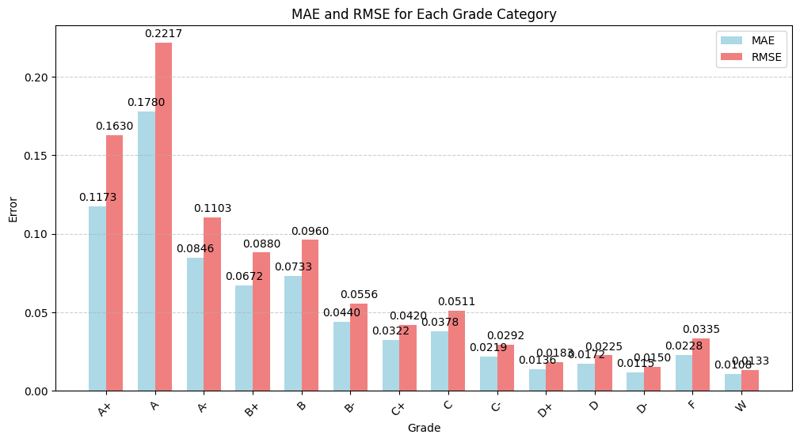
Neural Network Model
Previous: MAE = 0.0518，RMSE = 0.0911
Current: MAE: 0.0523, RMSE: 0.0658 (significantly reduced outliers)
pg11. Yixuan Li

Slide 12
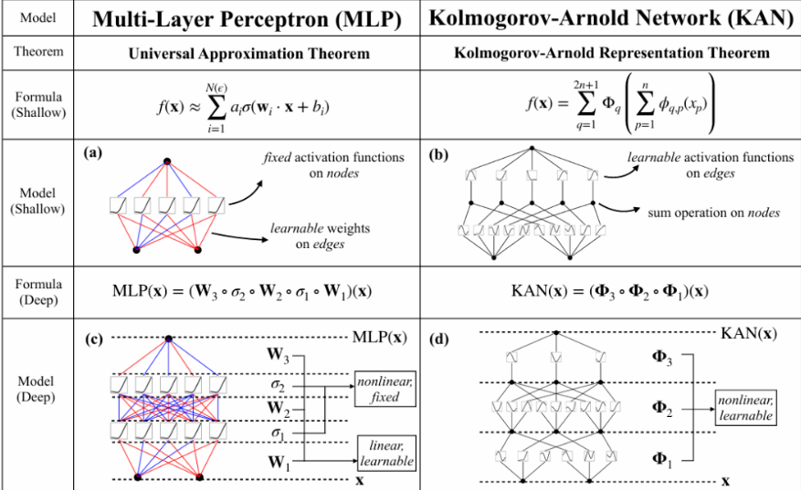
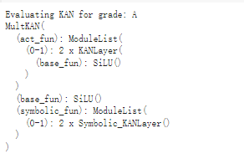
Kolmogorov–Arnold Neural Network (KAN)
pg12.Hongying Zhu

Slide 13
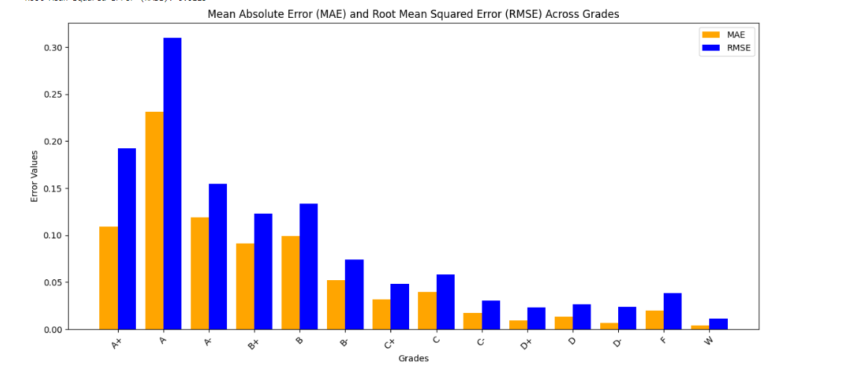

Kolmogorov–Arnold Neural Network (KAN)
Advantages
Based on the Kolmogorov–Arnold Representation Theorem:
Decomposes complex multivariate functions into simple univariate transformations and additive combinations, making the model structured and easy to understand.
Scalability for High-Dimensional Problems:
Effectively handles high-dimensional problems through layered design, reducing computational complexity and improving performance in such scenarios.
Strong Interpretability:
Each layer corresponds to a clear mathematical operation, enabling straightforward analysis and validation of the model’s internal logic.
Disadvantages
Sensitive to Hyperparameters:
Requires careful tuning of grid sizes, layer configurations, and regularization parameters, which can make the optimization process challenging and time-consuming.
High Computational Cost:
Training and inference can demand significant computational resources, especially for large datasets or complex models.
pg13.Hongying Zhu

Slide 14
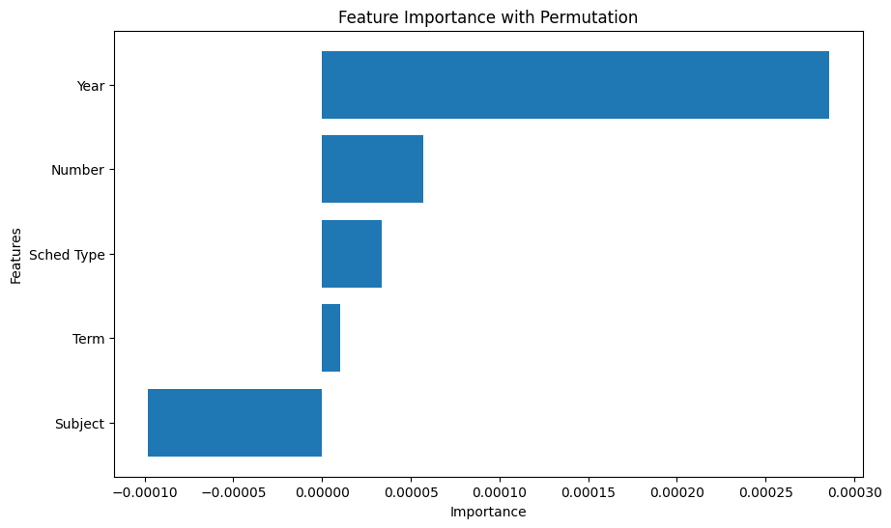
Feature Importance with Permutation
Impact scale is in the following order: Year > Number > Schedule Type > Term > Subject.
Year: Potential grade inflation over time.
Course Number: Introductory courses are known to be at 100 and 200 levels, and advanced classes are 300 and 400 levels.

Slide 15
Conclusion & Application
Model Comparison
 | Baseline Model | Neural Network Model | Kolmogorov–Arnold Neural Network (KAN)
Percent Of Error (MAE) | 5.18% | 5.23% | 4.99%
Model Application
Inputs: Year, Term, Subject, Sched Type, Number, and Course Title
Outputs: [0.1, 0.15, 0.1, ..., 0.05] corresponding to letter grade ['A+', 'A', 'A-', 'B+', 'B', 'B-', 'C+', 'C', 'C-', 'D+', 'D', 'D-', 'F', 'W']
Model Conclusion
Our Models are overall very good at predicting distribution of grades. We recommend the Kolmogorov–Arnold Neural Network (KAN) Model, since it have the lowest percent of error. Our stakeholders can use this model to predict the future grades based easy accessed course information. We recommend the stakeholders use this model predict the distribution of grades for a certain class. For example, If the actual percentage of students receiving an A is 31.00%, the model’s prediction would be between 29.5% and 32.6% on average. And this kind of prediction can be done for each grade level.

